Slide 1
Match Maker
Mesh Parameterization and Texture Mapping
Qiao C. Chaucey L. Chong G.

Slide 2

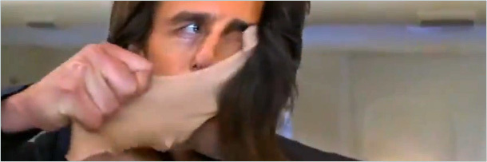
Intuition
Map 2D image on 3D face

Slide 3
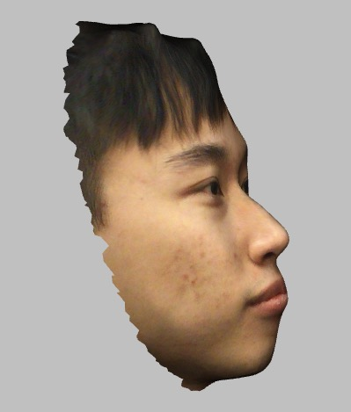
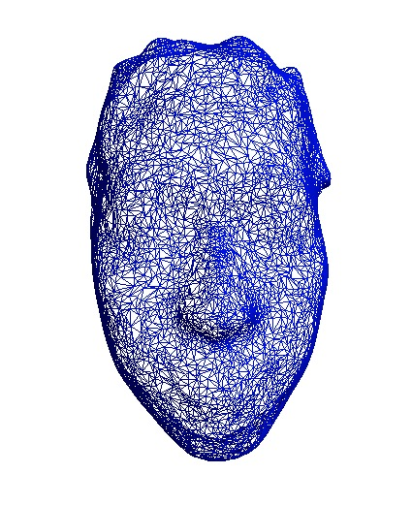
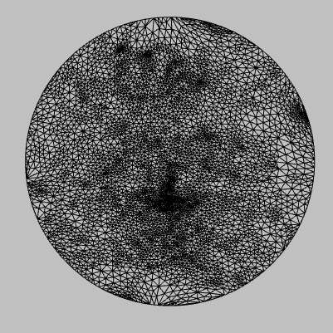
1.Modeling
2. Extract face
3.Tutte Embedding

Slide 4
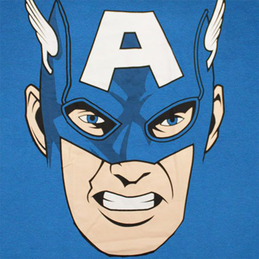
Next, Texture Mapping?
Method 1 – Direct Mapping
→
→
Coordinate mapping
Index mapping

Slide 5
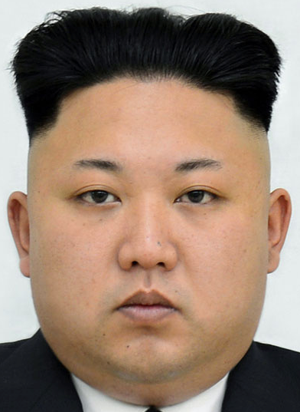

Result 1 – Direct Mapping

Slide 6
Result 1
This seems not bad because General Kim and our model have similar facial structures
However, tiger’s nose, mouth are not in place

Slide 7
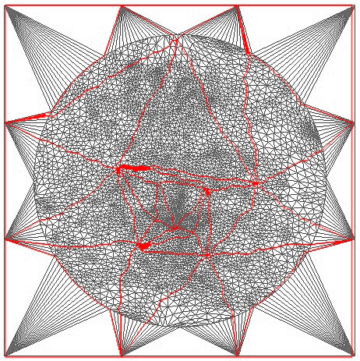
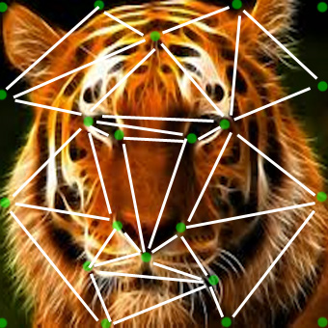
To avoid misplacing –
Match facial regions
Tiger
Face
Human
Face
mapping human’s forehead to tiger’s forehead
human’s face to tiger’s face
human’s nose to tiger’s nose

Slide 8
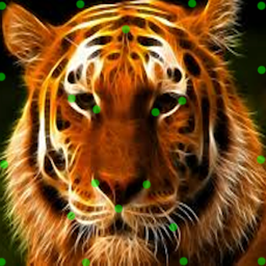
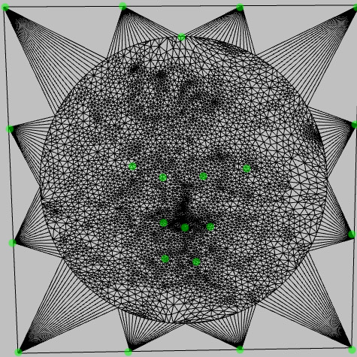
Match facial regions
- Constraint points
Human
Face
Tiger
Face

Slide 9
2 Matching facial regions - Triangulation
Tiger
Face
Human
Face

Slide 10
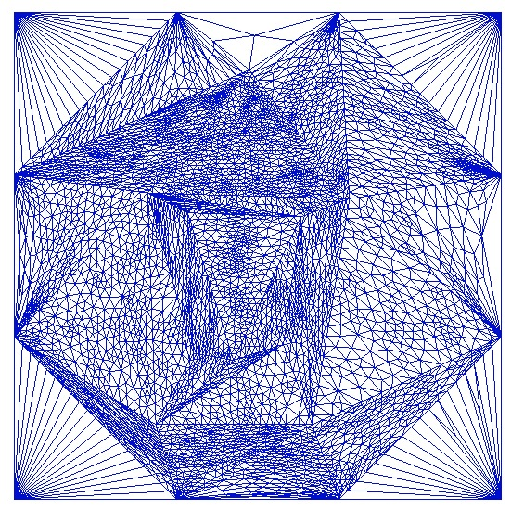
2 Adding constraints to mapping process
Tiger
Face
Human
Face
By Tutte embedding, we “stuff” human’s face vertices into tiger’s corresponding face regions

Slide 11
Next, texture mapping?
→
→
Coordinate mapping
Index mapping

Slide 12
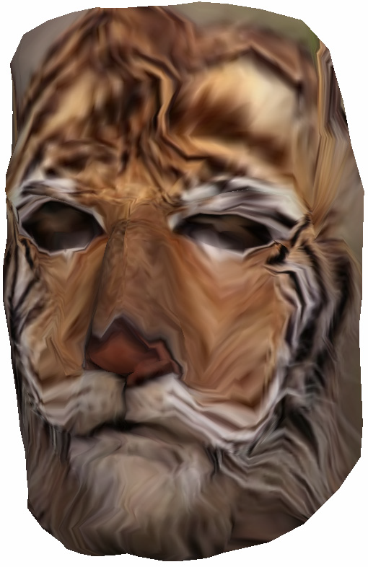
Result 2
Result 1
Pros: Eyes & nose are in place
Cons: Distorted (Tutte
Embedding’s fault)
Pros: Smooth
Cons: Eyes & nose not in place

Slide 13
Task Distribution
Qiao C.
- PPT resources
- Convert 3D model to .smf format
- Extract face from 3D model
- Tutte embedding 1
- Virtual bounding
- Provide constraint points
- Tutte embedding 2
- Idea of face flooding
Chauncey L.
Chong G.

Slide 14
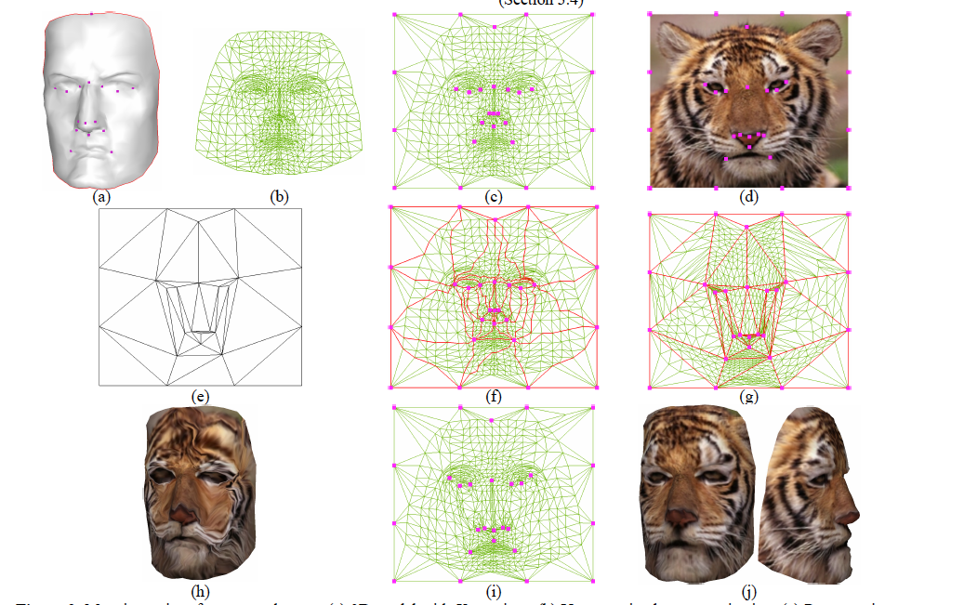
Acknowledgement
Matchmaker: Constructing Constrained Texture Maps
Vladislav Kraevoy Alla Sheffer Craig Gotsman
Computer Science Department, Technion-Israel Institute of Technology

